Slide 1

141xp Final Presentation
By Alex Andrada, Aditya Bharath, Johan Chua, Carolyn Wang, Xianya Fu, Maia Smolyanov, Ethan Shahzad
Client: Dr. Russ Wilcox
Winter 2025

Slide 2

Introduction
Goal: Analyze patterns in the Massachusetts’ legislative process
Key Research Questions:
Who are the most effective legislators?
What legislators work together?
What types of bills are tabled?
Are sponsors effective in getting through to committee?
What committees and chairs halt bills?
The data provided consisted of nested Json files, with each file containing information about Massachusetts legislation
We flattened these into a CSV file with 70,641 observations and 10 variables.
Because much of the information we wanted to analyze was in the "history" string variable, we used regular expressions to extract key text

Slide 3
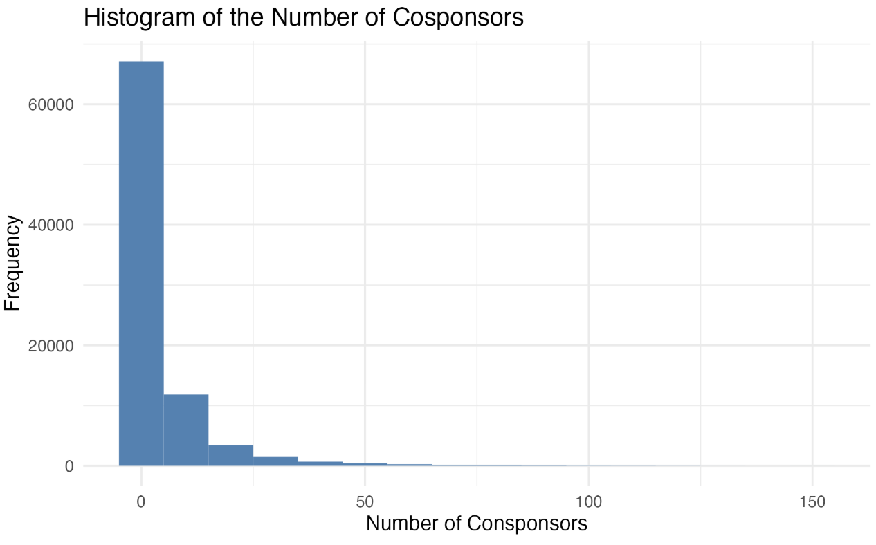
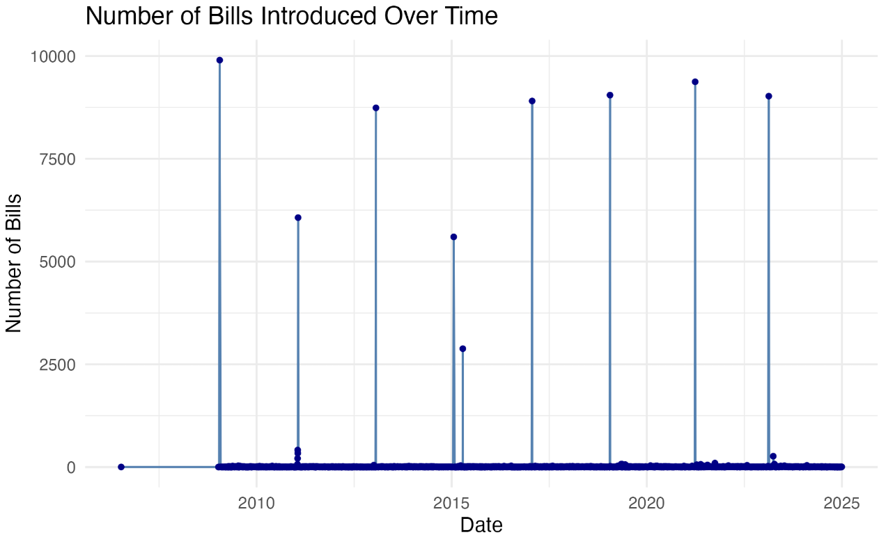
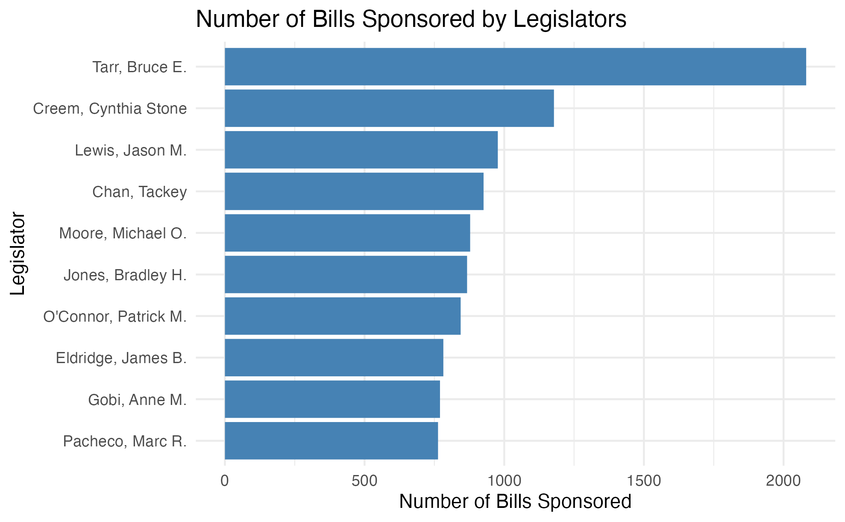
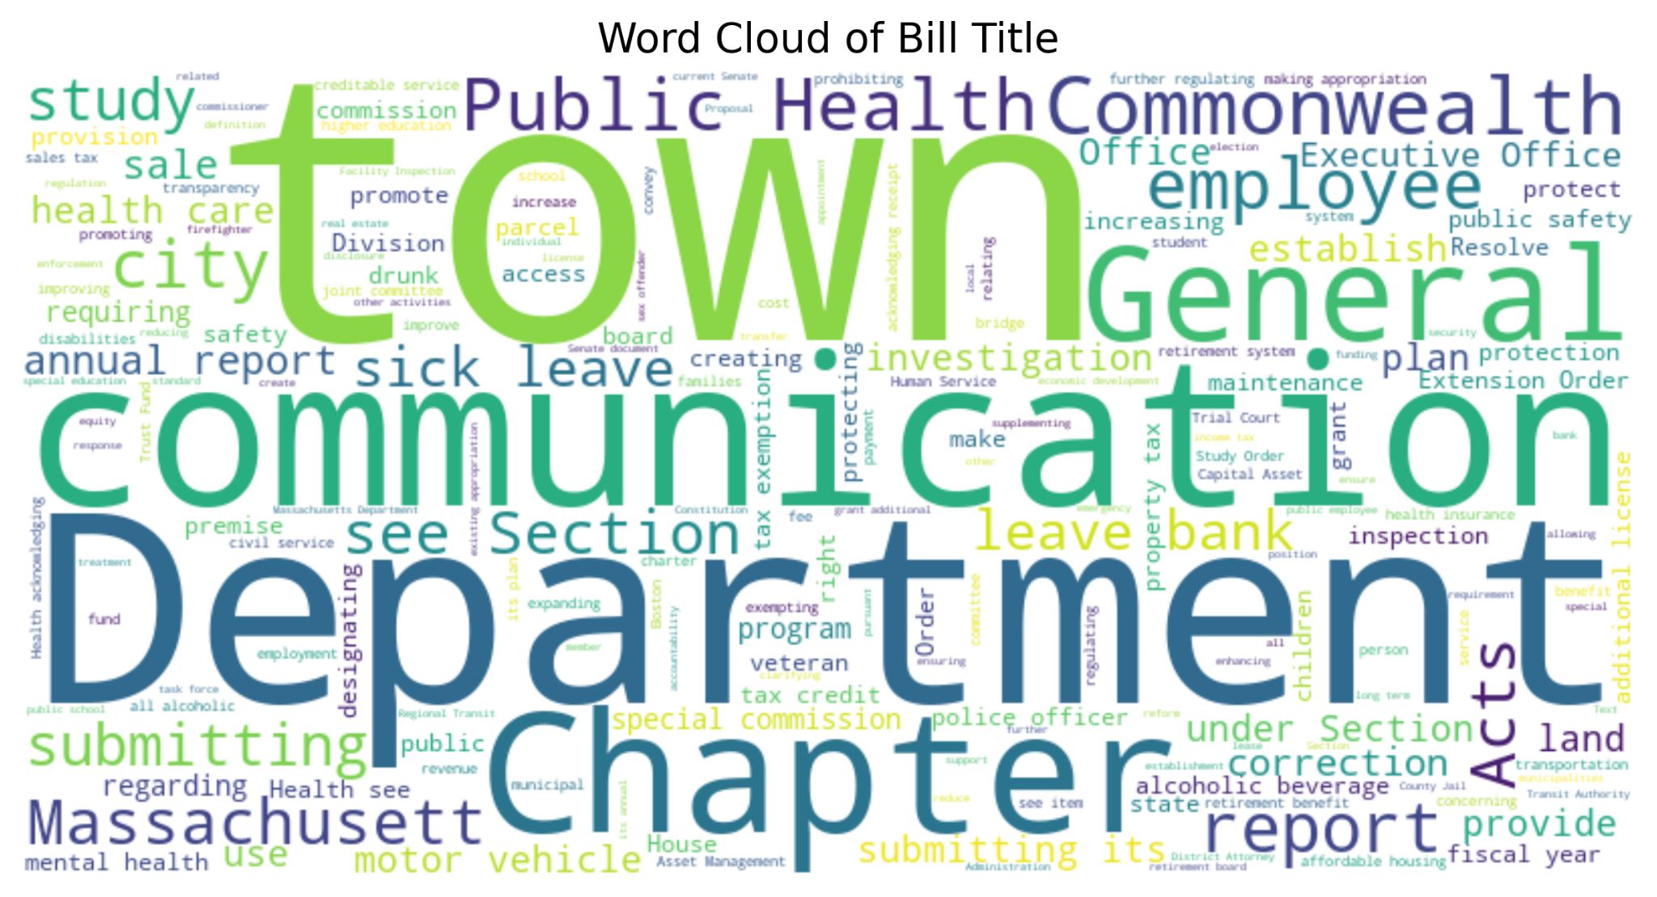
Exploratory Data Analysis
Initial findings reveal the legislators that introduced the most bills, that most bills had little to no cosponsors, and that legislative activity spikes, likely because bills are only allowed to be introduced on certain days. We also visualized the key words used in bill titles

Slide 4
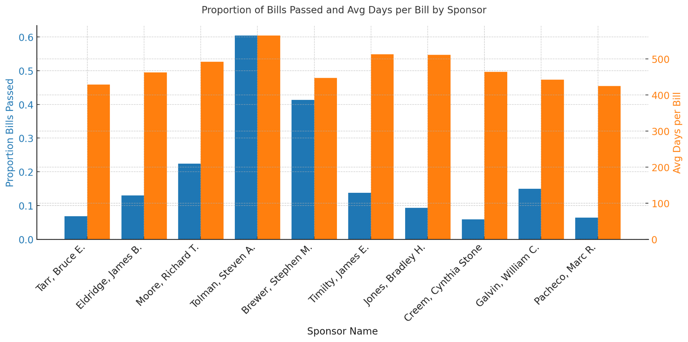
Most effective legislators
Most effective
Notes:
Combination of factors - some have very low number of bills proposed which falsely inflates proportion passed.
Most effective - Stephen Brewer, among the lowest avg days per bill + high proportion passed
His own - 145 proposed, 60 passed. 60 = middle of the pack.

Slide 5
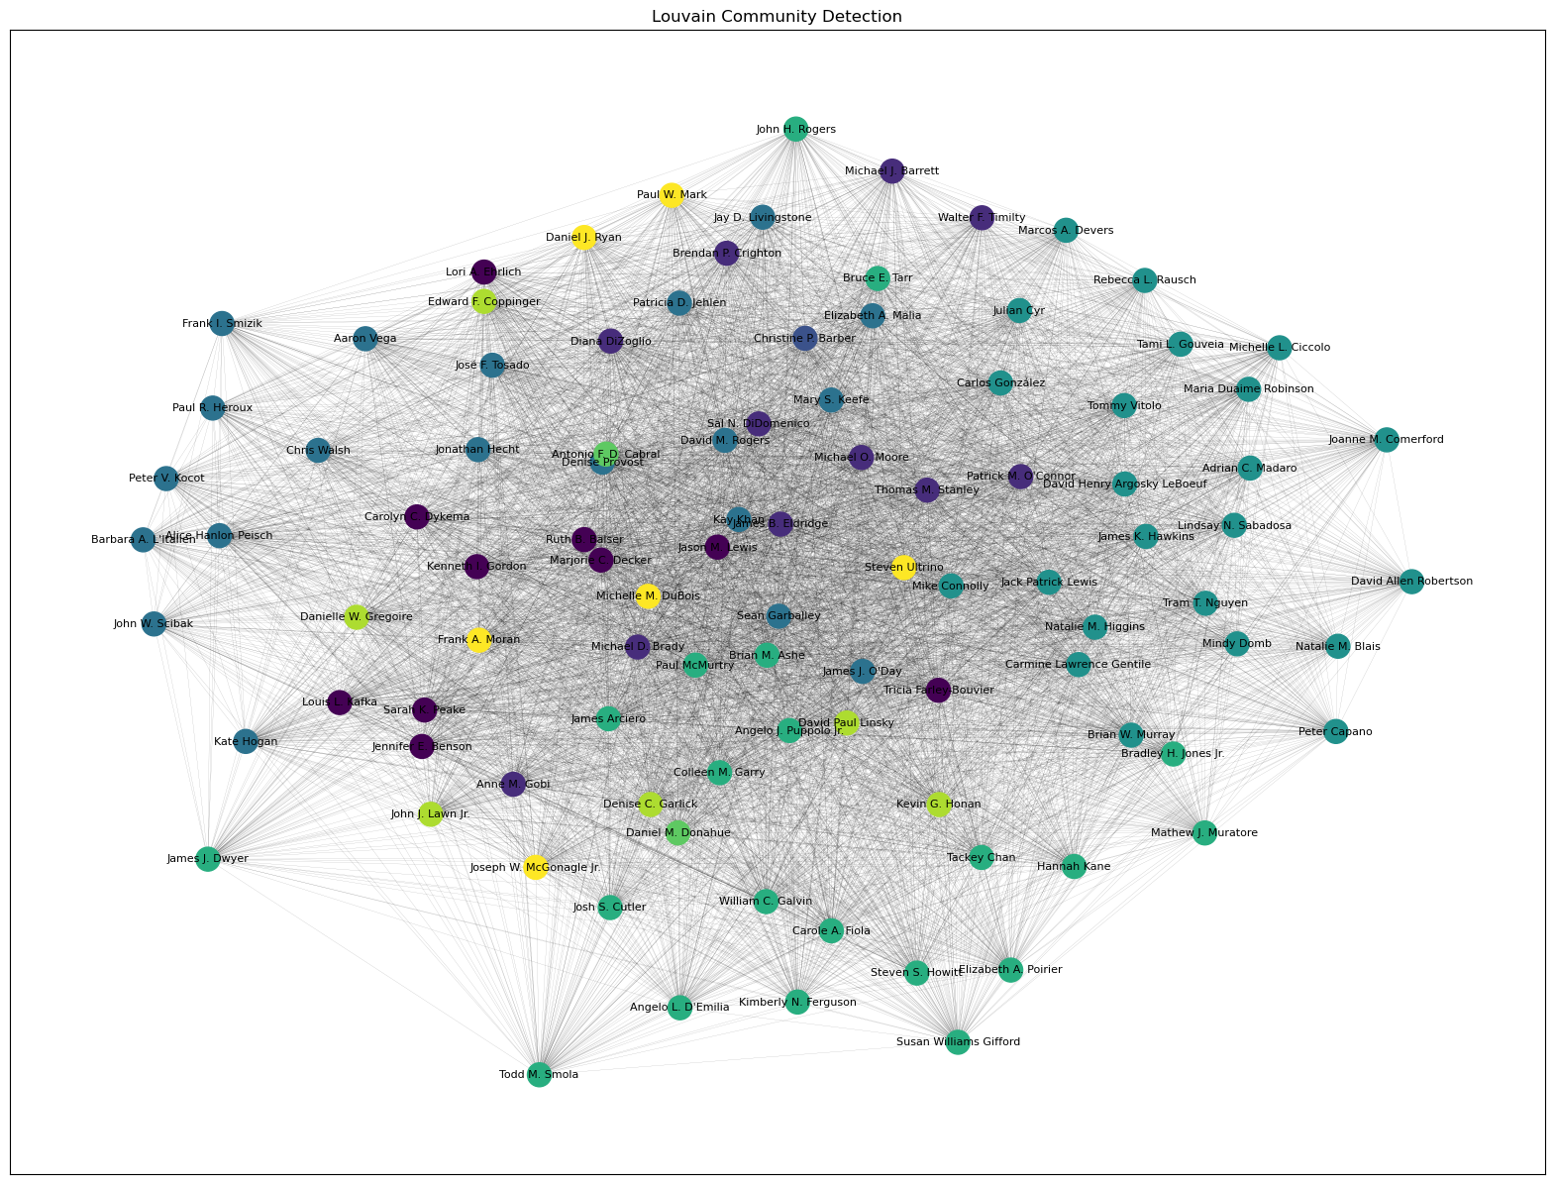
Who Works Together?
Group | Unique Defining Characteristic | Key Members
0 | Housing & Protection Focus | Jason M. Lewis, Ruth B. Balser
1 | Service-Oriented Programs | Jay D. Livingstone, Kevin G. Honan
2 | Strong Public Safety & Promotion | Tricia Farley-Bouvier, Christine P. Barber
3 | COVID-19 Concern | Kay Khan, Patricia D. Jehlen
4 | Town & Housing Focus | Lindsay N. Sabadosa, Mike Connolly
5 | Health & Safety Core | Elizabeth A. Malia, Daniel J. Ryan
6 | Children's Welfare Priority | Michael D. Brady, Frank A. Moran
7 | Education & State-Level Policies | David M. Rogers, Sean Garballey
8 | Balanced & Generalist Approach | James J. O'Day, Daniel M. Donahue
9 | Program-Centric Approach | Chris Walsh, Kate Hogan
10 | Strong Promotion & Protection | James B. Eldridge, Michael J. Barrett
11 | Service & Safety Advocacy | Paul McMurtry, James Arciero
12 | Emphasis on Protection & Promotion | Julian Cyr
13 | Program & Education-Driven | Susan Williams Gifford, Steven S. Howitt

Slide 6
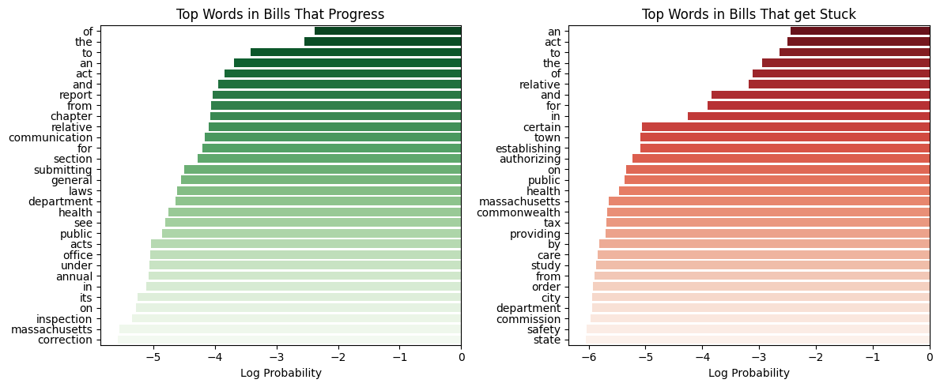
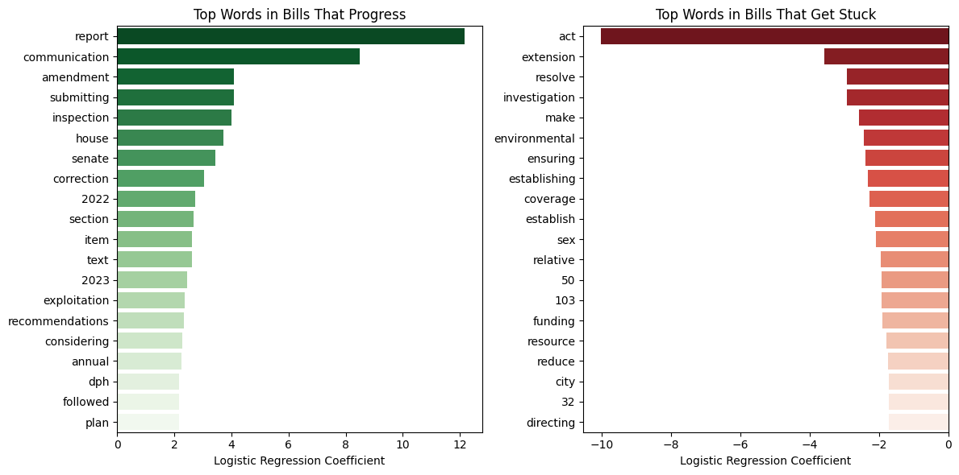
What Kinds of Bills are Tabled?
Multinomial Naive Bayes (92.3% Accuracy)
Log probability of each word appearing given the bill progresses or gets stuck.
One pattern shown by MNB is that words such as “annual,” “general,” and “correction” progress while “establishing,” and “authorizing” bills get stuck. This may indicate that recurring bills progress more easily than new bills.
Logistic Regression (92.5% Accuracy)
Change in log probability of classification of bill progressing or getting stuck.
Similar pattern as MNB appears
Specific issues addressed by bills that get stuck are those concerning the environment, sex, and cities.

Slide 7
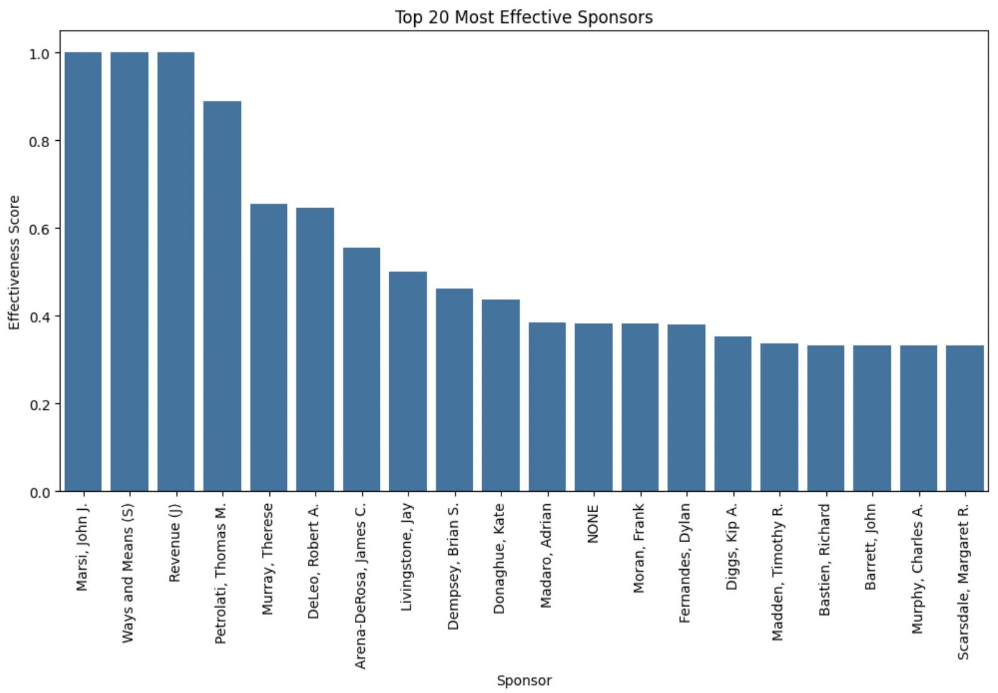
Legislative Sponsor Effectiveness in Massachusetts
Sponsor effectiveness varies widely across legislators.
Legislators like John J. Marsi, Ways and Means (S), and Revenue (J) achieved a 100% success rate.
Other sponsors, such as Thomas M. Petrolati (88.9%) and Therese Murray (65.5%), consistently had high bill passage rates.
Lower-tier sponsors, such as Richard Bastien and Charles A. Murphy, had only ~33% success, possibly due to less political influence or committee bottlenecks.
Notes:
This graph shows the top 20 most effective bill sponsors in Massachusetts. The legislators on the left side had higher success rates in passing their bills, suggesting stronger political influence, strategic bill selection, or leadership positions. Those on the right side, with lower scores, might face challenges such as lack of committee support or opposition from other legislators. Understanding these effectiveness scores can help us analyze how legislative success is distributed across different lawmakers.

Slide 8
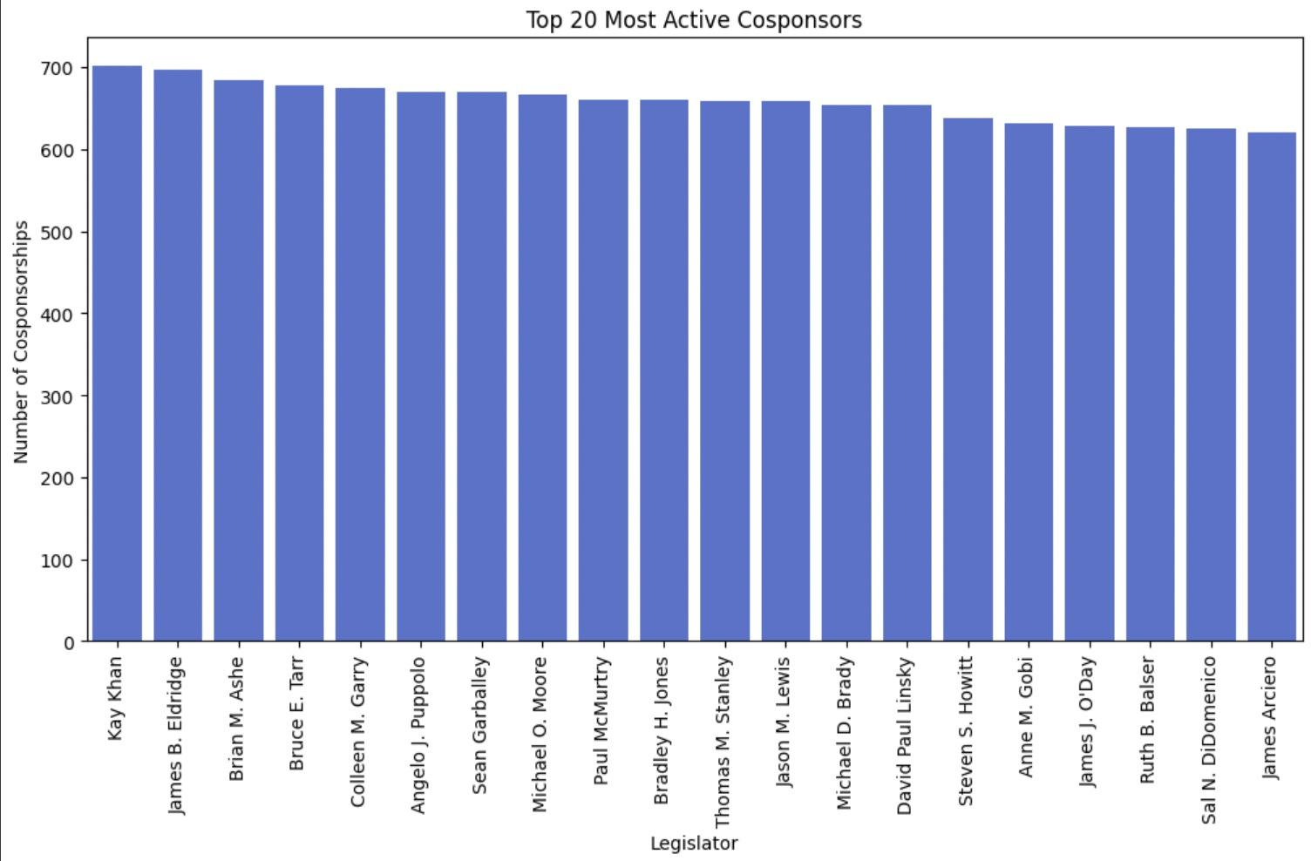
Most Active Cosponsers and Their Legislative Influence
Kay Khan, James B. Eldridge, and Brian M. Ashe are the most active cosponsors, each supporting nearly 700 bills.
High cosponsorship numbers may indicate political signaling rather than actual influence on bill passage.
Prior research suggests that cosponsorship does not directly correlate with bill success but helps in building coalitions.
Some legislators cosponsor many bills but have low success rates, while others sponsor fewer bills but get them passed.
Notes:
This graph highlights the top 20 most active cosponsors. These legislators frequently attach their names to bills, signaling party alignment or coalition-building efforts. However, research suggests that simply cosponsoring more bills does not necessarily mean these legislators have higher success rates in passing legislation. Instead, cosponsorship can serve as a political strategy to show support for party priorities or specific policy areas.

Slide 9
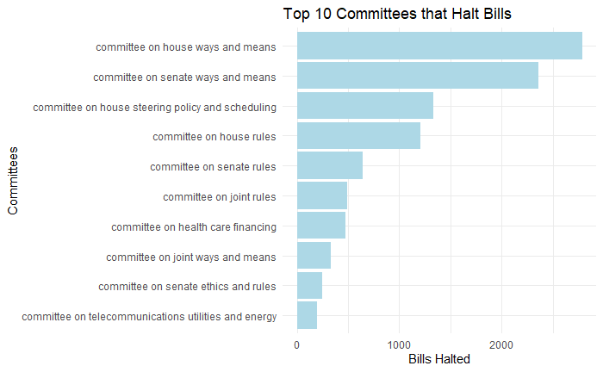
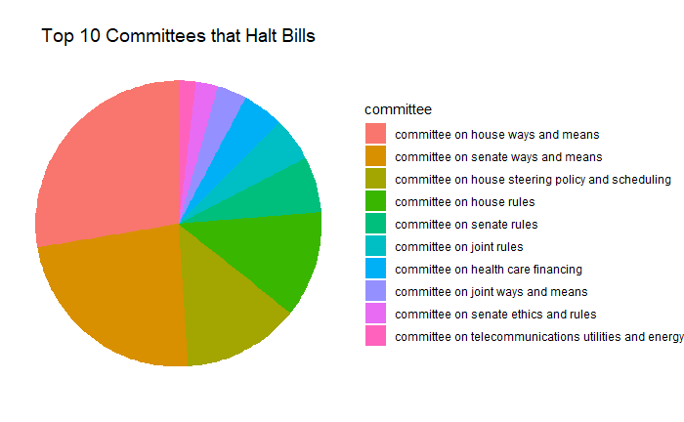
Which Committees Halt Bills?
Committees on house ways and means and committee on senate ways and means are influential in halting bills
There is a sharp taper in bill haltings when comparing the top ten halters
Committee on house ways and means and committee on senate ways and means take up over 50% of the total amount of bills halted by the top ten
The suggests that financial and procedural committees are strong factors in determining which bills progress through the legislative process.

Slide 10
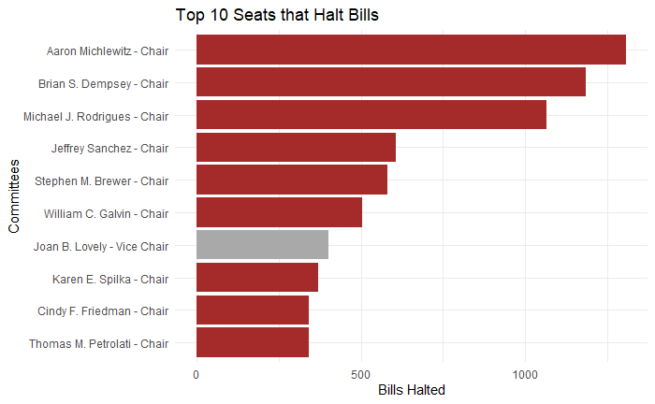
Which Chairs Halt Bills?
Aaron Michlewitz, Brian S. Dempsey, and Michael J. Rodrigues have a dominant lead compared to other chairs when it comes to halting bills
Top 3 have done multiple terms with the high impact committees
Follows the same trend, show a strong lead for the top few compared to the rest

Slide 11
Drawing a Conclusion
Our Findings
The most effective legislator was Stephen Brewer, under our definition of effectiveness which balanced the proportion of bills passed and the number of days per bill.
We also found distinct groups of legislators that commonly work together with their unique policy focuses.
We found a statistically significant relationship between co-sponsorship and bill passage, but a similar passage rates for solo-sponsored and cosponsored bills.
The bills that progress or get stuck have shared characteristics which varied depending on the model used. “Communication” was a top word for bills that progress.
The "Committee on House Ways and Means" and the "Committee on House Rules" are the highest offenders when it comes to halting bills. Aaron Michlewitz, Brian S. Dempsey, and Michael J. Rodrigues are chairs that halt bills.
Future research: See how well our findings align with future bill activity, explore and compare legislation from other states, and consult with legislative experts to better understand our results.

